Slide 1
Kubernetes 101
Marcial White

Slide 2
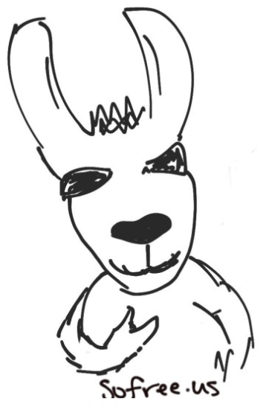
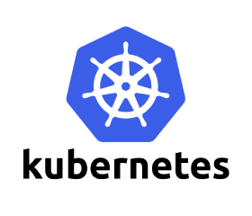
Introductions
Marcial White
Senior Engineer @ Return Path, Inc.
Five+ k8s clusters (2 datacenter/3 AWS)
This koolaide is delicious!
Mind the compendium!

Slide 3
Choose your own adventure
Ubuntu 18 w/ Budgie VM provided
All tools pre-installed
You’ll still have to configure them
Install yourself
All instructions + links to info in the compendium
Tested in MacOS, Linux
Not all accounts are necessary – use my images if you don’t want to build them yourself

Slide 4
Kuberwhaties?
Kubernetes is an open-source platform for automating deployment, scaling, and operations of application containers across clusters of hosts, providing a container-centric infrastructure.
CNCF
K8s

Slide 5
Kuberwhaties?
Kubernetes: Greek for "helmsman”
'koo-ber-nay'-tace'
OG’s (original googlers): Joe Beda, Brendan Burns, Craig McLuckie, Brian Grant, Tim Hockin
1.0 hit mid-2015
Heavily influenced by Google's Borg system
Original codename @ Google was Project Seven
The Star Trek 'friendlier' Borg
Seven spokes on the wheel of the Kubernetes logo is a nod to the original codename.

Slide 6
Kuberwhaties?
What this course is:
101-level, familiarize yourself with (lots) of basics
Offer links to more information on every topic
Basic micro-service application design principles
Explore containers using docker
Deliver a scalable AWS-based Kubernetes cluster
Host an Internet Radio Station as a workload
Examine some extra features like in-cluster LB & DNS

Slide 7
Kuberwhaties?
More advanced topics include:
Break down all Kubernetes components & objects
A review of AWS features
A discussion in security/RBAC
In-depth monitoring or troubleshooting
Advanced development life-cycle (release mgmt)
Cluster federation

Slide 8


Kuberwhaties?
Much of this course was taken directly from Kubernetes.io and Docker.io
This world is constantly evolving, get in on the discussion!

Slide 9
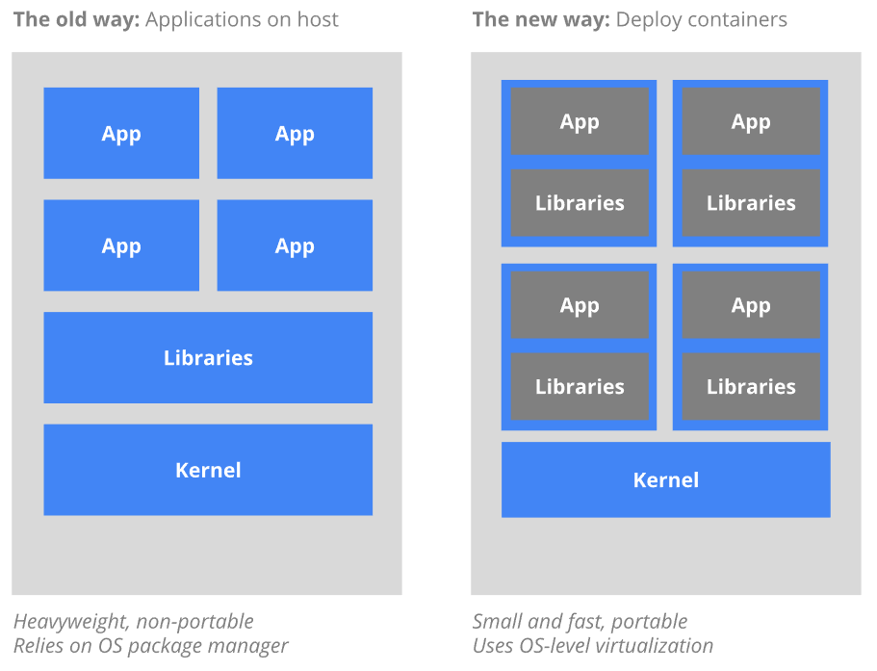
Kuberwhaties?
Virtual Machines
Many OS’s on one
Shared libs & kernel
Containers
Individual libs
No OS overhead

Slide 10
State of Clustering
Docker Swarm
East to start, harder to customize
CoreOS Fleet
Low-level orchestration, lacks features
Discontinued Feb 2018 – CoreOS/RH now focus K8s
Apache Mesos
Highly scalable, less opinionated, more complex
Kubernetes
Opinionated, use 12 factor!
Probes, CrashLoopBackoff, HPA, Open APIs!

Slide 11
12 Factor Application Design
‘Properly’ designed apps:
Containers deployed and managed in a highly flexible and automatic way
Can provide greater uptime of your app
Better and more predictable performance
Less hands-on management vs. ‘old way’
NOT a silver-bullet
NOT always feasible

Slide 12
12 Factor Application Design
The twelve-factor app is a methodology for building software-as-a-service apps that:
Use declarative formats for setup automation
Provide clean contracts w/ OS
Are suitable for modern cloud platforms
Minimizes environmental divergence
Many factors are built-in to K8s object designs

Slide 13
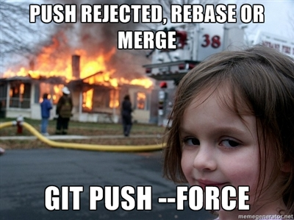
12 Factor Design
1) Codebase
ALWAYS USE SOURCE CONTROL
Single codebase, multiple deploys
https://github.com/mars64
https://gitlab.com/sofreeus

Slide 14
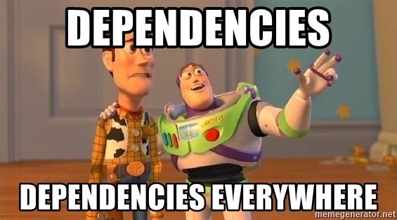
12 Factor Design
2) Dependencies
Explicitly declare & isolate dependencies
Never rely on implicit system packages
No dropping shells!
Bake into a container!

Slide 15

12 Factor Design
3) Configuration
Config varies across deploys, code does not
Can the codebase be made open source right now?
Environment variables!
Helm is great for this … but that’s another topic

Slide 16

12 Factor Design
4) Backing Services
Treat backing services as attached resources (db, event frameworks, mail services, etc)
No distinction between local & third party services
Expect to interface with external services at a simple URL
memcache.default.svc.cluster.local
memcache

Slide 17

12 Factor Design
5) Buid/Release/Run
Strictly separated build/release/run stages
Build: transform code into a build (e.g. image)
Release: combine the build and config into a release (e.g. map env vars)
Run: Deploy the app into the execution environment (e.g. Kubernetes)

Slide 18
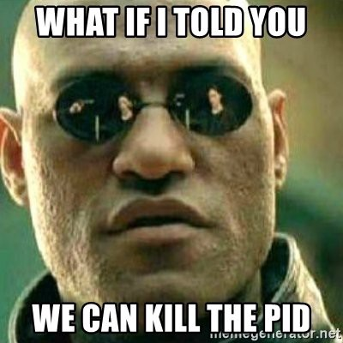
12 Factor Design
6) Process model
App: one or more stateless processes
Share-nothing! (use a db, block store, queue, etc)
Crash-only design

Slide 19

12 Factor Design
7) Port binding
Export services via port binding
If backing services = interfacing w/ external services at simple URLs, then port binding = providing simple URLs to be interfaced with
dockerfile expose
k8s spec ports

Slide 20
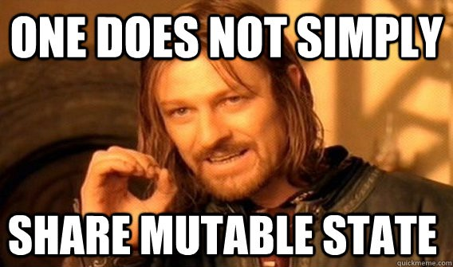
12 Factor Design
8) Concurrency
Scale out via the process model
Stateless! Share-nothing! Crash-only!

Slide 21
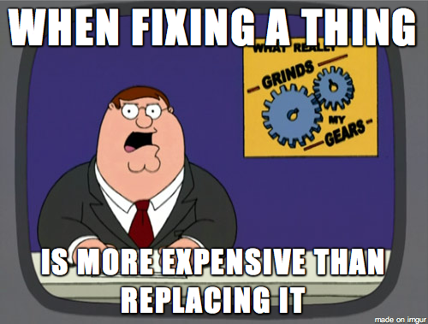
12 Factor Design
9) Disposability
Maximize robustness w/ fast startup and graceful shutdown
CRASH-ONLY

Slide 22
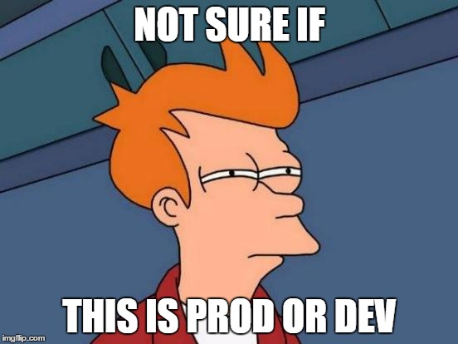
12 Factor Design
10) Dev/Prod parity
All envs should be as similar as possible
Easy continuous delivery
Backing service names should be the same

Slide 23
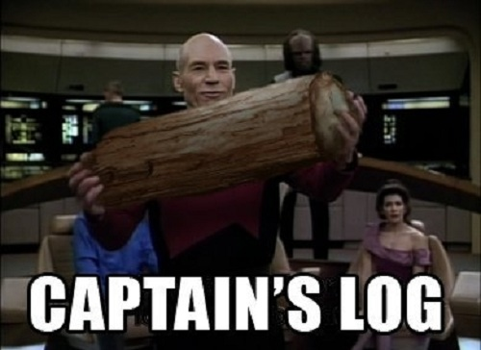
12 Factor Design
11) Logs
Event streams
Easy as ABC: Always Be …. logging to stdout 😐
Splunk/ELK/Scalyr, etc…

Slide 24

12 Factor Design
12) Admin tasks are one-off processes
Use the same dependency isolation techniques
Don’t run pods just for admin tasks!

Slide 25
State of Container Runtimes
Docker
Rkt
Containerd + runc
LXC + LXD
The list goes on …

Slide 26
Docker
In 2017, Docker (the company) decided to differentiate Docker (the commercial software products CE & EE) from Docker (the open source project, now Moby)
Versions went from 1.12.x -> 17.x -> 18.x
Docker-edge & k8s bundling
Minikube

Slide 27

Docker

Slide 28
Docker
Image
Lightweight, standalone executable package
Everything necessary to run a piece of software
Code, runtime, libraries, env vars, configs, etc
Build an image
docker build –t myrepo/mycontainer:mytag .

Slide 29
Docker
Container
A runtime instance of an image
Runs completely isolated from host env by default
Accesses host files, ports, etc only when configured
Run a container
docker run --rm --it myrepo/mycontainer:mytag bash

Slide 30
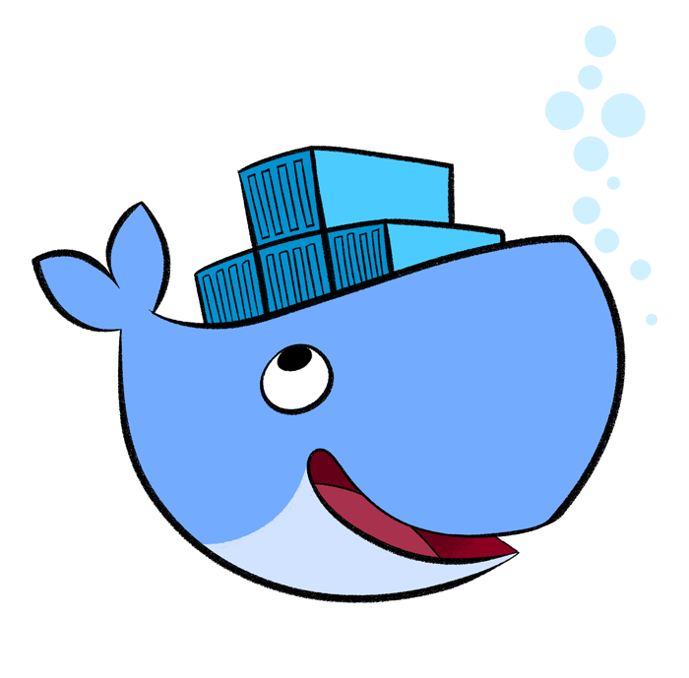
Docker
Docker Engine is a client-server app
A server, daemon process (dockerd)
A REST API to communicate w/ daemon
A CLI client (docker)
Bridged networking by default

Slide 31
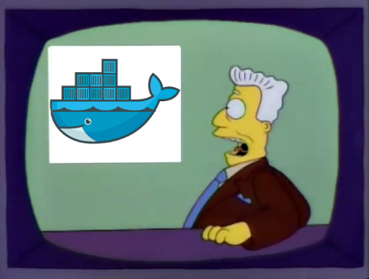
Docker Lab!

Slide 32
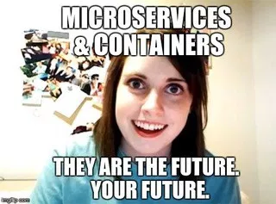
Docker Lab Retro

Slide 33
Kubernetes System Design
In it’s most simple form, a K8s cluster consists of two types of resources:
Masters coordinate the cluster and their workloads
Also provides the apiserver
Workers (nodes) provide compute for the workloads
Uses an agent – the kubelet to communicate w/ masters via API
Runs a container runtime, like docker, rkt, containerd, etc …
Extra credit: key/value store
Kops will configure this to run on the masters

Slide 34
Kubernetes System Design
Networking layers
Host local networking
Docker runtime networking, on a host
Cluster networking overlay for docker-to-docker
WeaveNet
Kops supports many overlays, we’ll use Weave
A virtual network connecting Docker containers across multiple hosts, enabling automatic discovery

Slide 35
Kubernetes System Design
The four networking problems
Highly coupled container-to-container
Containers within pods see each other via localhost
Pod-to-Pod
Names from KubeDNS, addresses via Overlay
Pod-to-Service
Names from KubeDNS, addresses via Overlay
External-to-Service
Via the K8s Services object

Slide 36
Kubernetes System Design
The k8s approach to the four problems:
Container-to-container without NAT
Node-to-container without NAT
IP a container sees itself is the same as others see it
Services expose internally by default
“default deny”
CNI
Many overlay providers: Weave, Flannel, Calico, etc

Slide 37
Kubernetes System Design
To deploy into K8s, apply a configuration script (in yaml) that describes a resource
This notifies the master that an object needs to be scheduled on a node
Interface with the system through the API, or write your own!

Slide 38
Kubernetes System Design
Resources (aka Objects) are persistent
Describe the containerized workloads
Resource requirements & limits
Policies around behavior (restart, replicas, etc)
K8s uses them to represent the cluster states
Desired vs. Current

Slide 39

Kubernetes System Design
Kubernetes objects are “records of intent”
By creating an object you’re telling Kubernetes what you want your workload to look like; this is your cluster’s desired state
Once you create the object, the Kubernetes system will continuously work to ensure the object exists in the current state.

Slide 40
Kubernetes System Design
Object fields
Spec
User defined
Characteristics you want the object to have
Status
System defined
Describes the actual state of the object

Slide 41
Kubernetes System Design
Specs (aka manifests) are defined in YAML
Required fields include:
apiversion
kind
metadata (starting with name)
The rest depends on what you’re building

Slide 42
Kubernetes System Design
apiVersion: apps/v1beta1
kind: Deployment
metadata:
name: nginx-deployment
spec:
replicas: 3
template:
metadata:
labels:
app: nginx
spec:
containers:
- name: nginx
image: nginx:1.7.9
ports:
- containerPort: 80

Slide 43
Kubernetes System Design
Check the user’s guide for complete list
Common resources include:
Deployments/replicasets/pods
Services
ConfigMaps
Secrets
We won’t use all of the types today

Slide 44
Kubernetes System Design
Resource Collision Domain
Names
Namespace-specific
Namespaces
Virtual clusters
Labels & Selectors
Maps pods to services!
Annotations
Relies on cloud provider

Slide 45
Kubernetes System Design
Names
Spatially unique
Max 253 characters
Lower alphanumeric, dash, period
UID
Generated by the system
All objects get a UID
Spatially and temporally unique

Slide 46
Kubernetes System Design
Namespaces
”virtual clusters”
Provides scope for names
intended for use in large environments
Less than 10 users? You probably don’t need one.
Handy for Role-Based Access Control

Slide 47
Kubernetes System Design
Namespaces
Default
Objects with no other namespace go here
Kube-system
Objects created by the K8s system … kubedns, proxy, etc
Kube-public
Demonstration namespace provided by the kubeadm tool
Not all objects require namespaces
Nodes, persistent volumes, etc

Slide 48
Kubernetes System Design
KubeDNS
Kops provides the KubeDNS pod by default
Lives in the kube-system namespace
Creates cluster-resolvable DNS names for pods and services
<service-name>.<namespace-name>.svc.cluster.local
<pod-name>.<namespace-name>.pod.cluster.local
Names are mapped to overlay addresses for cross-cluster communication

Slide 49
Kubernetes System Design
Labels & Selectors
Key/value pairs attached to objects for ID
Relevant to users, but do not imply semantics
Unique per-object
Used for organization & mapping pods to services
Mostly small, unstructured data
Labels & selectors themselves do not provide uniqueness of the object

Slide 50
Kubernetes System Design
Handy for interacting with sets of objects
Two ways to filter:
Equality-based
$ kubectl get pods –l env=prod,tier=frontend
Set-based
$ kubectl get pods –l ‘env in (prod),tier in (frontend)’

Slide 51
Kubernetes System Design
Annotations
Key/value pairs that attach metadata to objects
Can be used to manage resources based on the cloud-provider configuration
Kops will provide us with a pre-configured AWS cloud provider
Load Balancers, Certificates, Security Groups, etc …
Can also interact with workloads
External-DNS…

Slide 52
Kubernetes System Design
apiVersion: v1
kind: Service
metadata:
name: nginx
annotations:
service.beta.kubernetes.io/aws-load-balancer-internal: 0.0.0.0/0
service.beta.kubernetes.io/aws-load-balancer-backend-protocol: http
service.beta.kubernetes.io/aws-load-balancer-ssl-cert: arn:aws:acm:us-east-1:XXXXXXXX
service.beta.kubernetes.io/aws-load-balancer-ssl-ports: "443"

Slide 53
Kubernetes System Design
Liveness
Kubelet uses these checks (aka probes) to know when to restart a container
Generally requests a port or path, expects 200
Readiness
Kubelet uses these checks to know when to route traffic to a pod
Pods can be alive but not ready for traffic
Generally hits an endpoint that implies application readiness

Slide 54
Kubernetes System Design
livenessProbe:
tcpSocket:
port: 80
initialDelaySeconds: 10
periodSeconds: 10
readinessProbe:
httpGet:
path: /customer_facing_page/db_is_ready.php
port: 80
initialDelaySeconds: 5
timeoutSeconds: 1
periodSeconds: 20

Slide 55
Kubernetes System Design
More specs in the API Reference to better define your workload
K8s works to realize the desired state
That’s nice and all, but how do you build clusters?!?

Slide 56
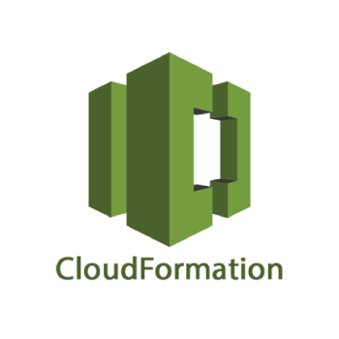
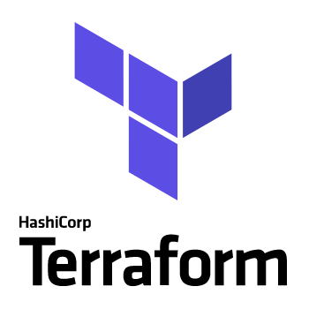


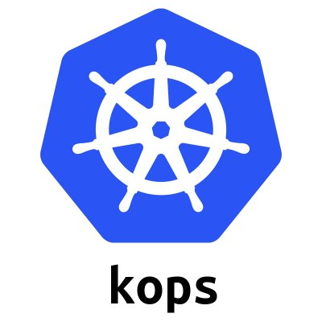
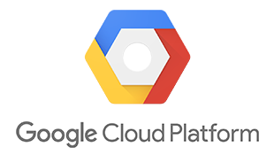
Decisions …

Slide 57
Kops
Enables Infrastructure as Code
Outputs to terraform, cloudformation, yaml, etc
Code: review & versioning is easy
Reproducible
Declarative configuration files
Well-supported cloud provider development

Slide 58
Kops
Production-ready cluster tool
(At time of writing) 1.9.3
Single or multi-master
We’ll start with singletons for the labs
Cluster rolling-upgrades
Also supports digitalocean, google cloud ...

Slide 59
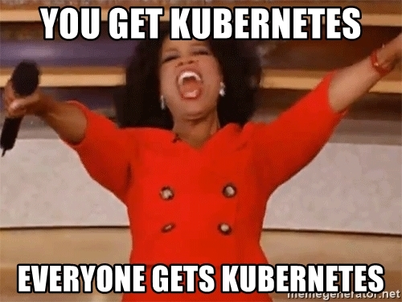
Kubernetes Lab 1 - Kops

Slide 60
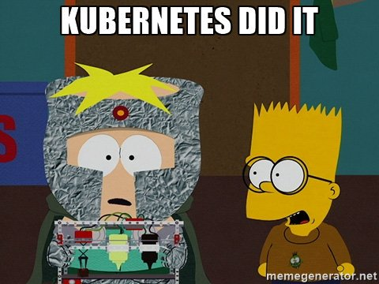
Kubernetes Lab 1 - Retro

Slide 61

Kubernetes Lab 2 - Icecast

Slide 62
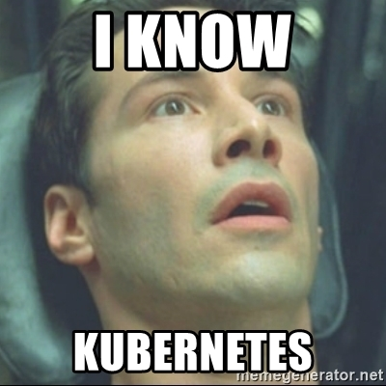
Kubernetes Lab 2 - Retro

Slide 63
Productionization
Open Discussion!
Dangers of cluster-managed LB and DNS
On-premises/Cloud
Split out the key/value store
Multi-master
Multi-node
Annotations
Monitoring/Metrics/Alerting
Build/Deploy - CI/CD
Pod Design - Sidecars

Slide 64
Thank you for your time!
github.com/mars64
binary.stereo@gmail.com
Jungletrain.net
RinseAndRepeatRadio.com
DnBRadio.com
Recondnb.net

